Slide 1





Billionaires
DATA ANALYSIS & VISUALIZATION
PROJECT 2 – GROUP 5

Slide 2


DATA ANALYSIS & VISUALIZATION PROJECT 2 – GROUP 5 - members
ANH HUONG
DANIELA CORNEA
MINO PERIC

Slide 3
MAIN Datasets
Forbes Billionaires of 2021 – Version 1
https://www.kaggle.com/roysouravcu/forbes-billionaires-of-2021
Forbes Billionaires of 2021 – Version 2
https://www.kaggle.com/alexanderbader/forbes-billionaires-2021-30/version/3
Forbes Real-time Billionaires
https://www.forbes.com/real-time-billionaires/#178d85b83d78

Slide 4
Scope and methods
Scope
Analyze and visualize world’s billionaires' data
Tools and Methods
Python
Flask/API
HTML/CSS
JavaScript
SQL/MongoDB
D3, Leaflet, Dimple

Slide 5
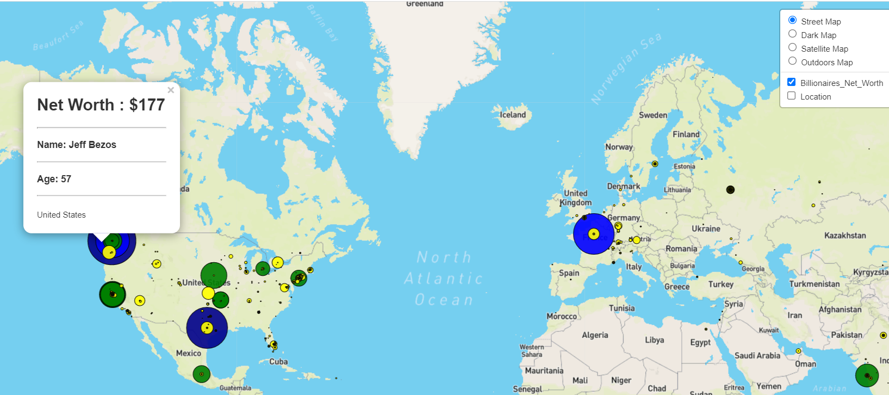
leaflet
Use Leaflet to visualize net worth of billionaires on various Mapbox layers
Allow user to choose the layer and the way the data is displayed
Use markers with adjusted size and color for the value of the net worth

Slide 6
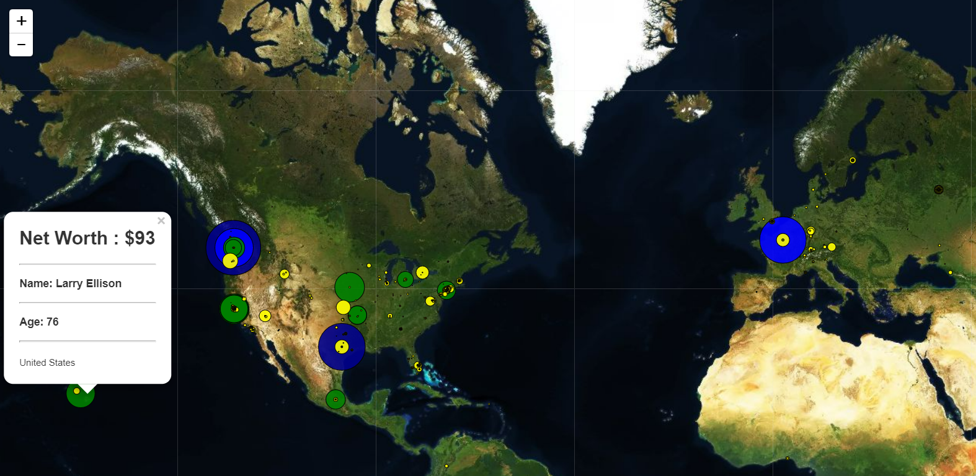
leaflet
Satellite map
Net worth markers color: dark blue $150+, blue $150, green $100, yellow $50, gold $1-
Markers size linked to the value of the net worth

Slide 7
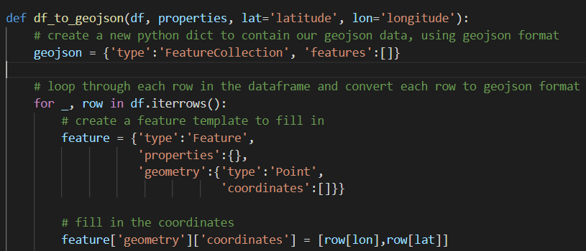
Leaflet - challenges and overcoming them
Finding data with GEOJSON format acceptable for Leaflet
Use python to transform data into GEOJSON

